Slide 1
Interim Decision Rules for Early Futility: A Comparative Assessment of Bayesian and Frequentist Approaches
J. Kyle Wathen, PhD
VP Scientific Strategy and Product Innovation
Cytel
Bayes 2025, Leiden
Oct 2025

Slide 2
Motivations for the Proposed Talk
Interim decision-making is an integral part of efficient clinical trial design
Its benefits include:
  The incorporation of current and previously observed trial data
  The prediction of future outcomes based on Bayesian predictive probabilities compared to a frequentist approach which computes conditional power at the observed delta
  Decision-making for trial conduct using informed priors or more advanced modeling approach, eg Bayesian hierarchical model for the control data
  Bayesian predictive probabilities can incorporate past, current, and potential future data

Slide 3
Potential Options for Futility Decision
Frequentist Conditional Power
Conditional power thresholds based on Observed Difference – Native in East Horizon
Bayesian Predictive Probabilities
Incorporating prior data directly into the prior, weighted – Requires R integration
Bayesian Predictive Probabilities
Bayesian Hierarchical model for the response rate on control to include data for previous trials – Requires R Integration
Difference in Observed Rates
If the observed difference is small, then stop for futility – Native to East Horizon

Slide 4
An Oncology Case Study
Standard Frequentist Design Parameters
Design Parameter | Input
Endpoint Type | Binary
Sample Size | 210
1-sided Type 1 Error | 0.025
Target Power | 90%
Number of Interim Analyses | 1 at 50% Information Fraction (IF)
Efficacy Boundary | Lan-DeMets (OBF)
Scenario Parameter | Input
Response Proportion for Control Arm | 0.20
Response Proportion for Treatment Arm | 0.40
Start Simple
A group sequential design as a point of comparison for adaptive features and analysis options
Notes:
Boaz

Slide 5
An Oncology Case Study
Standard Frequentist Design Parameters
Design Parameter | Input
Endpoint Type | Binary
Sample Size | 210, 250, 290, 310
1-sided Type 1 Error | 0.025
Number of Interim Analyses | 1 at 40%, 50%, 60 IF
Efficacy Boundary | Lan-DeMets (OBF)
Futility based on conditional power | 0.1, 0.01
Scenario Parameter | Input
Response Proportion for Control Arm | 0.20
Response Proportion for Treatment Arm | 0.40
Adding Additional Designs
Sample Sizes
Information Fraction
Futility: Conditional Power
Explore Trade-offs
= 24 designs added to the simulation
Notes:
Boaz

Slide 6
An Oncology Case Study
Standard Frequentist Design Parameters
Design Parameter | Input
Endpoint Type | Binary
Sample Size | 210, 250, 290, 310
1-sided Type 1 Error | 0.025
Number of Interim Analyses | 1 at 40%, 50%, 60 IF
Efficacy Boundary | Lan-DeMets (OBF)
Futility based on observed delta | 0.01, 0.05, 0.1
Scenario Parameter | Input
Response Proportion for Control Arm | 0.20
Response Proportion for Treatment Arm | 0.40
Adding Additional Designs
Sample Sizes
Information Fraction
Futility: Observed Delta
Explore Trade-offs
= 36 designs added to the simulation
Notes:
Boaz

Slide 7
Prior Study Data on Control
Study | Sample Size | Number of Responses
1 | 61 | 10
2 | 154 | 33
3 | 164 | 37
4 | 65 | 11
5 | 143 | 29
6 | 215 | 38
7 | 88 | 24
8 | 121 | 19
9 | 129 | 34
10 | 91 | 16
Total | 1231 | 251
Best Approach to Include?
Beta Binom – Prior mean equal 20%, Sample size of1
Beta Binom – Prior mean equal to 20%, Sample size to 616 (50%), 1231 (100%)
Hierarchical Bayesian Model
Overall Response Rate: 20.3%
Notes:
Boaz

Slide 8
Include External/Historical Data in Prediction
External data available that is available at the interim may be utilized to make the futility decision, aka “Totality of the data”
  Variety of methods for inclusion of external data or historical
  Why not include this in the simulation when conducting the prediction?
  Inclusion of previous data in analysis is beyond the scope of the presentation

Slide 9
Bayesian Model
    For simplicity assume a conjugate model
    X ~ Binary( π_{i} ) for i = C (Control) or E (Experimental)
  Analysis Priors
  π_{c} ~ Beta( 0.20, 0.80 )
  π_{E} ~ Beta( 0.20, 0.80 ) Assume prior response rate is same C/E
  Decision Criteria
  Efficacy:
  p = Pr(π_{E} > π_{c} | data ) > P_{U} → E is better than C
  Futility:
  Pred Prob{ [Pr(π_{E} > π_{c} | data at final ) > P_{UFinal}] | data at Interim } < PL
  Prior 1: Non-informative π_{c} ~ Beta( 0.20, 0.80 )
  Prior 2: 50%, π_{c} ~ Beta( 126, 490 )
  Prior 3: 100%, π_{c} ~ Beta( 251, 980 )
Notes:
Valeria

Slide 10
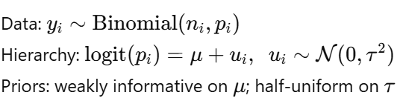
Hierarchical Bayesian Model
  Prediction
  Include prior study data and the data at the interim to obtain samples of the control response rate for the current trial using JAGS with the following model:
  Decision Criteria
  Analysis prior
  Efficacy:
  p = Pr(π_{E} > π_{c} | data ) > P_{U} → E is better than C
  Futility:
  Pred Prob{ [Pr(π_{E} > π_{c} | data at final ) > P_{UFinal}] | data at Interim } < PL
Notes:
Valeria

Slide 11
An Oncology Case Study
Simple Bayesian Approach (Conjugate Prior)
Design Parameter | Input
Endpoint Type | Binary
Sample Size | 210, 250, 290, 310
1-sided Type 1 Error | 0.025
Number of Interim Analyses | 1 at 40%, 50%, 60 IF
PU (At Interim Analysis) | PU = 0.995
PU Final | 0.98
PL | 0.1, 0.01
Scenario Parameter | Input
Response Proportion for Control Arm | 0.20
Response Proportion for Treatment Arm | 0.40
Adding Additional Designs
Sample Sizes
Information Fraction
Futility Cutoff
Prior
24 designs added to the simulation for each Bayesian Approach
Total Bayesian designs added to simulation: 96
Total Frequentist designs added to simulation: 60
Total Designs: 156
Notes:
Boaz

Slide 12
Sensitivity Analysis
Impact of different control response rates
Control Response Rate | Experimental Response Rate
0.20 | 0.20, 0.25, 0.30, 0.40
0.15 | 0.15, 0.20, 0.25, 0.35
0.25 | 0.25, 0.30, 0.35, 0.45
Futility Goals
In the alternative, teams want less than 1%-2% probability of declaring futility
Minimum probability of futility in null cases of 50%
Notes:
Boaz

Slide 13
Possible Drawback
    These Bayesian options are not currently native to East Horizon
    Not proficient in R
      Don’t want to develop an entire code base for the simulations to include Bayesian options
    Already have R code available for both types of Bayesian analysis
    Don’t want to use East Horizon for frequentist designs and develop all the code for the Bayesian designs
Notes:
Valeria

Slide 14
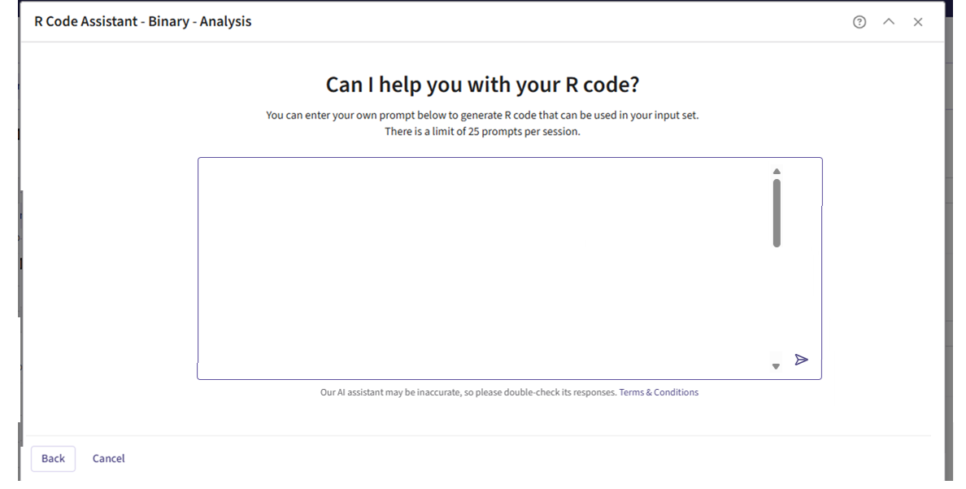
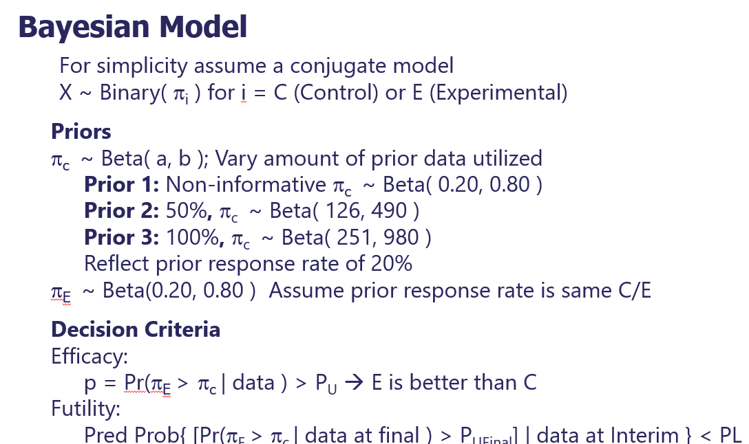
Implementation of Bayesian Analysis

Slide 15
Implementation of Bayesian Analysis
I need help with a function that will perform a Bayesian analysis where I assume a beta prior and will use the posterior probability for decision making. At the interim analysis, I the posterior probability is above PU then stop early for success and if not check the futility rule. In addition, at the interim analysis I would like to have a futility check where I compute the Bayesian predictive probability of success using the same Bayesian analysis the end of the trial but using a posterior probability greater than PUFinal to determine success. If the predictive probability of success at the end of the study is less then PL at the interim analysis then stop the trial for futility

Slide 16
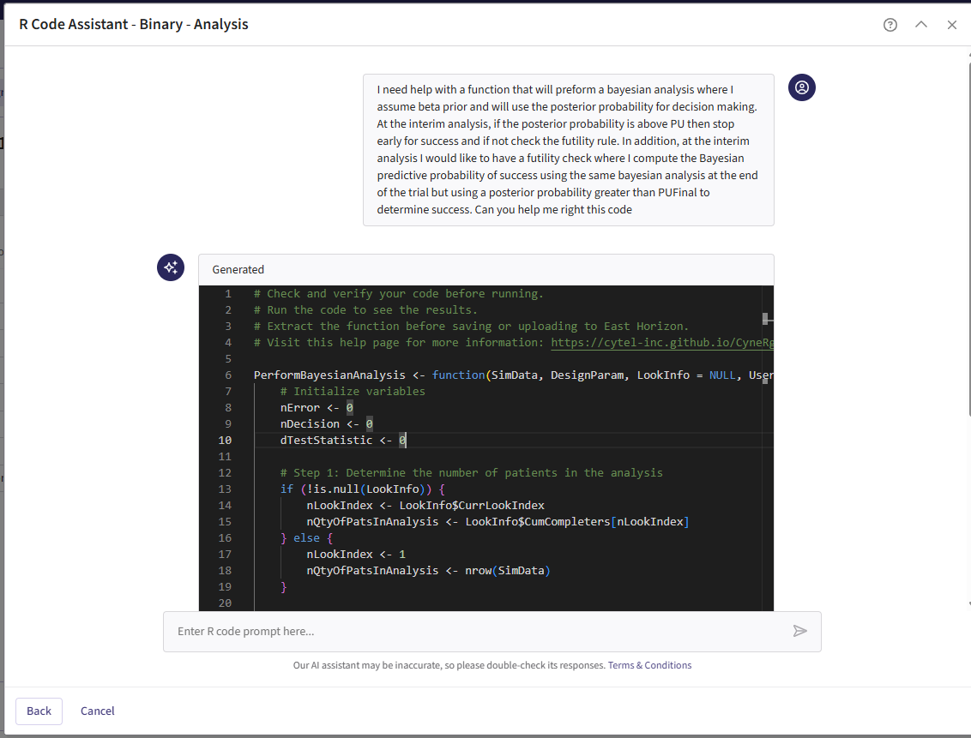

Slide 17
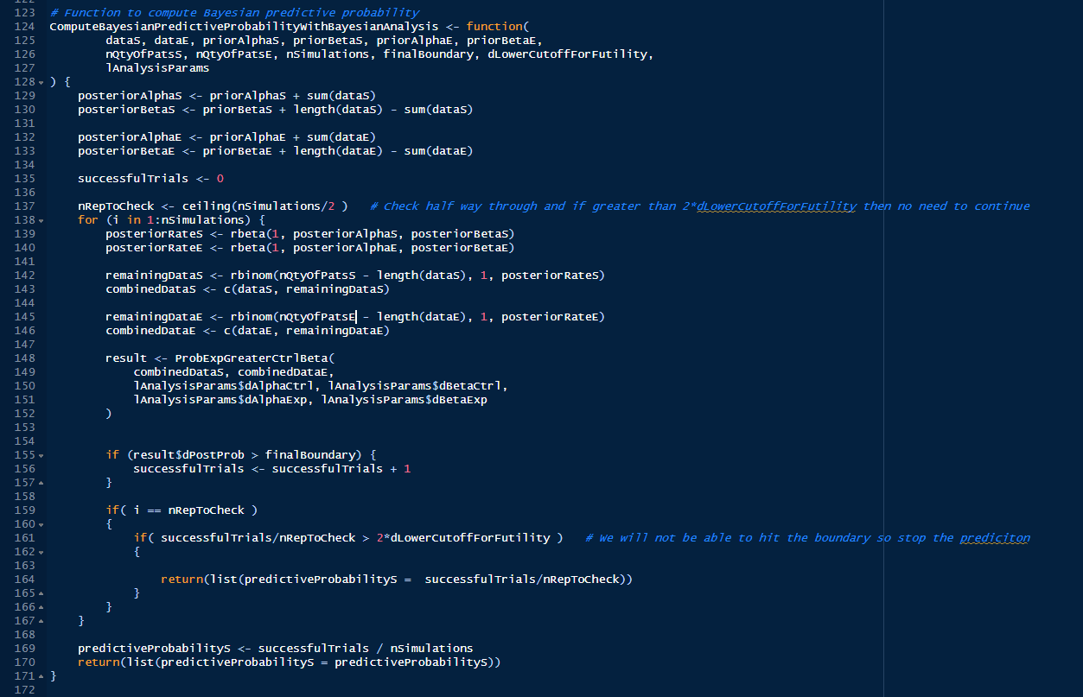

Slide 18
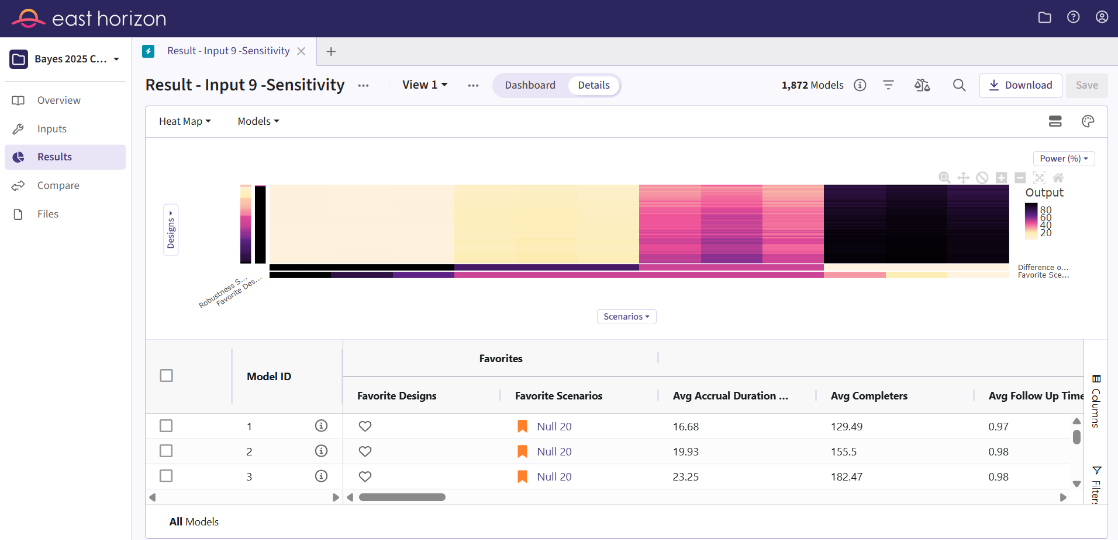

Slide 19
Sensitivity Analysis
Impact of different control response rates
Control Response Rate | Experimental Response Rate
0.20 | 0.20, 0.25, 0.30, 0.40
0.15 | 0.15, 0.20, 0.25, 0.35
0.25 | 0.25, 0.30, 0.35, 0.45
Futility Goals
In the alternative, teams want less than 1%-2% probability of declaring futility
Minimum probability of futility in null cases of 50%
Notes:
Boaz

Slide 20
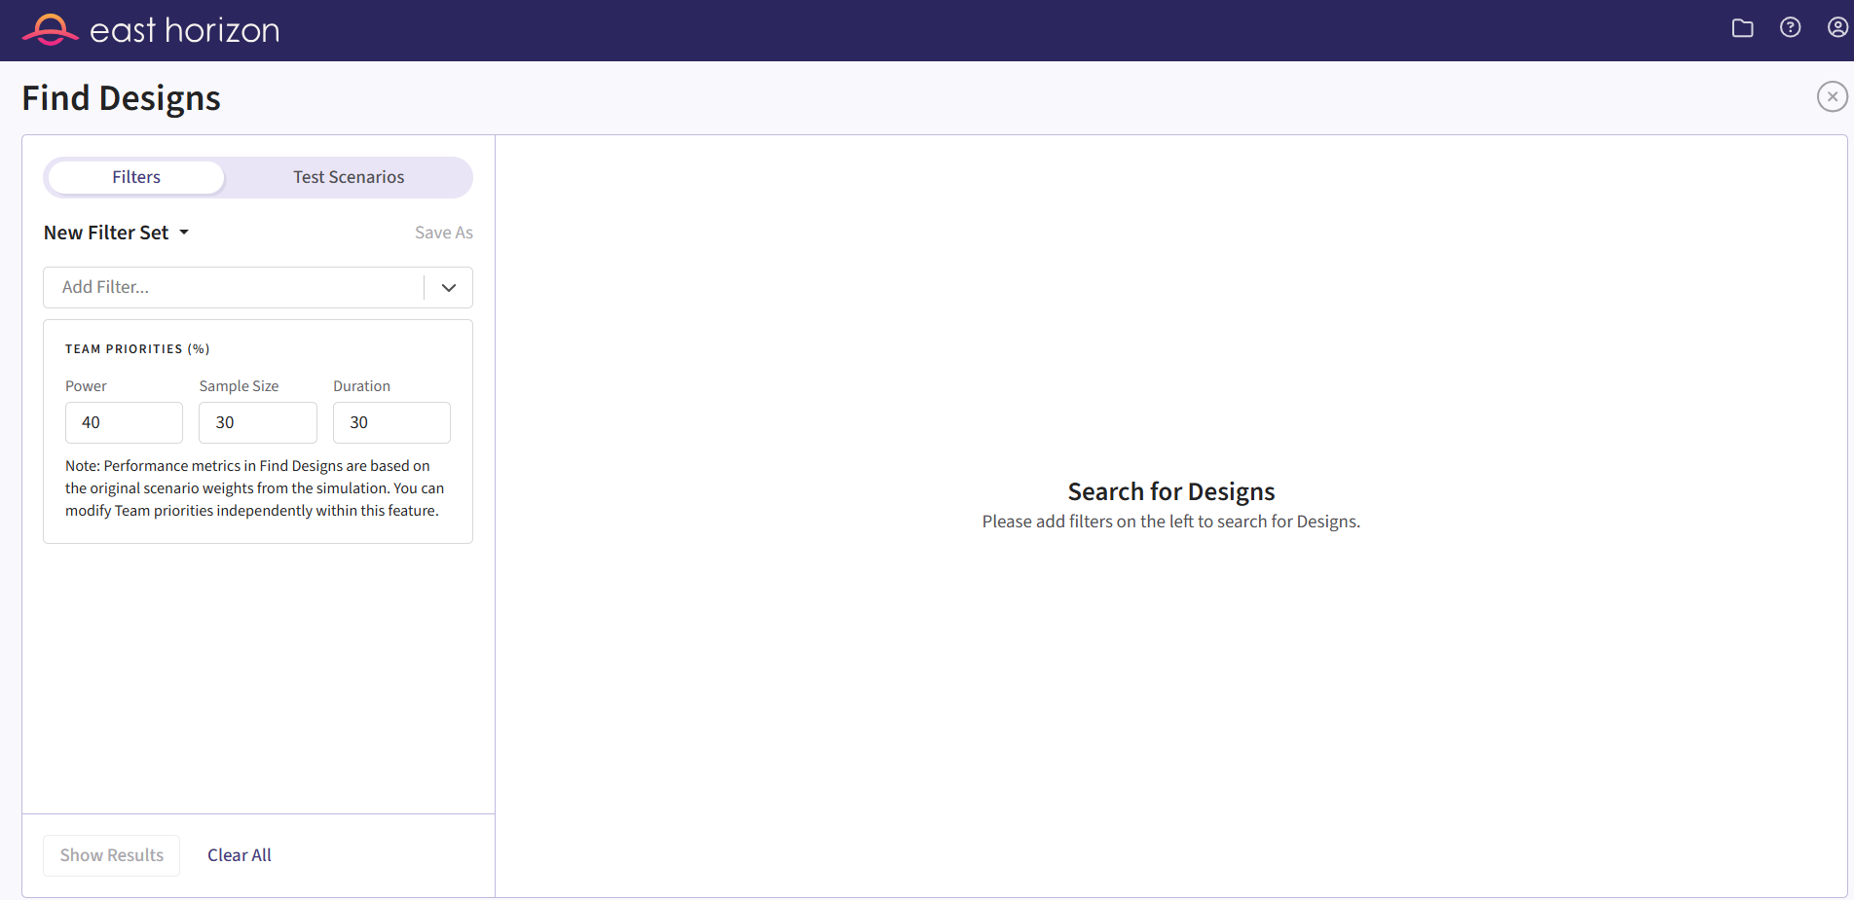

Slide 21
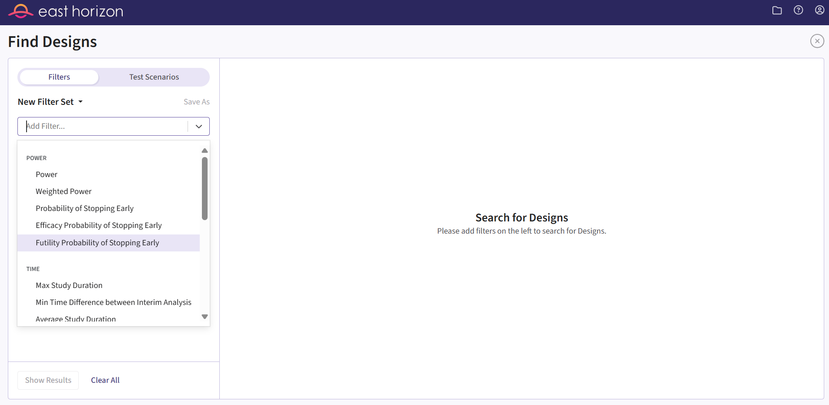

Slide 22
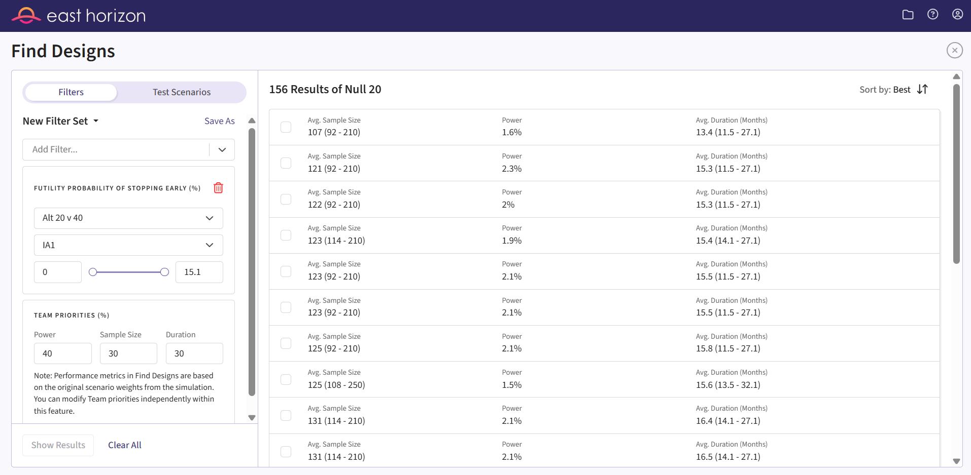
Some designs had a 15.1% chance of stopping for futility in the alternative case 20% vs 40%

Slide 23
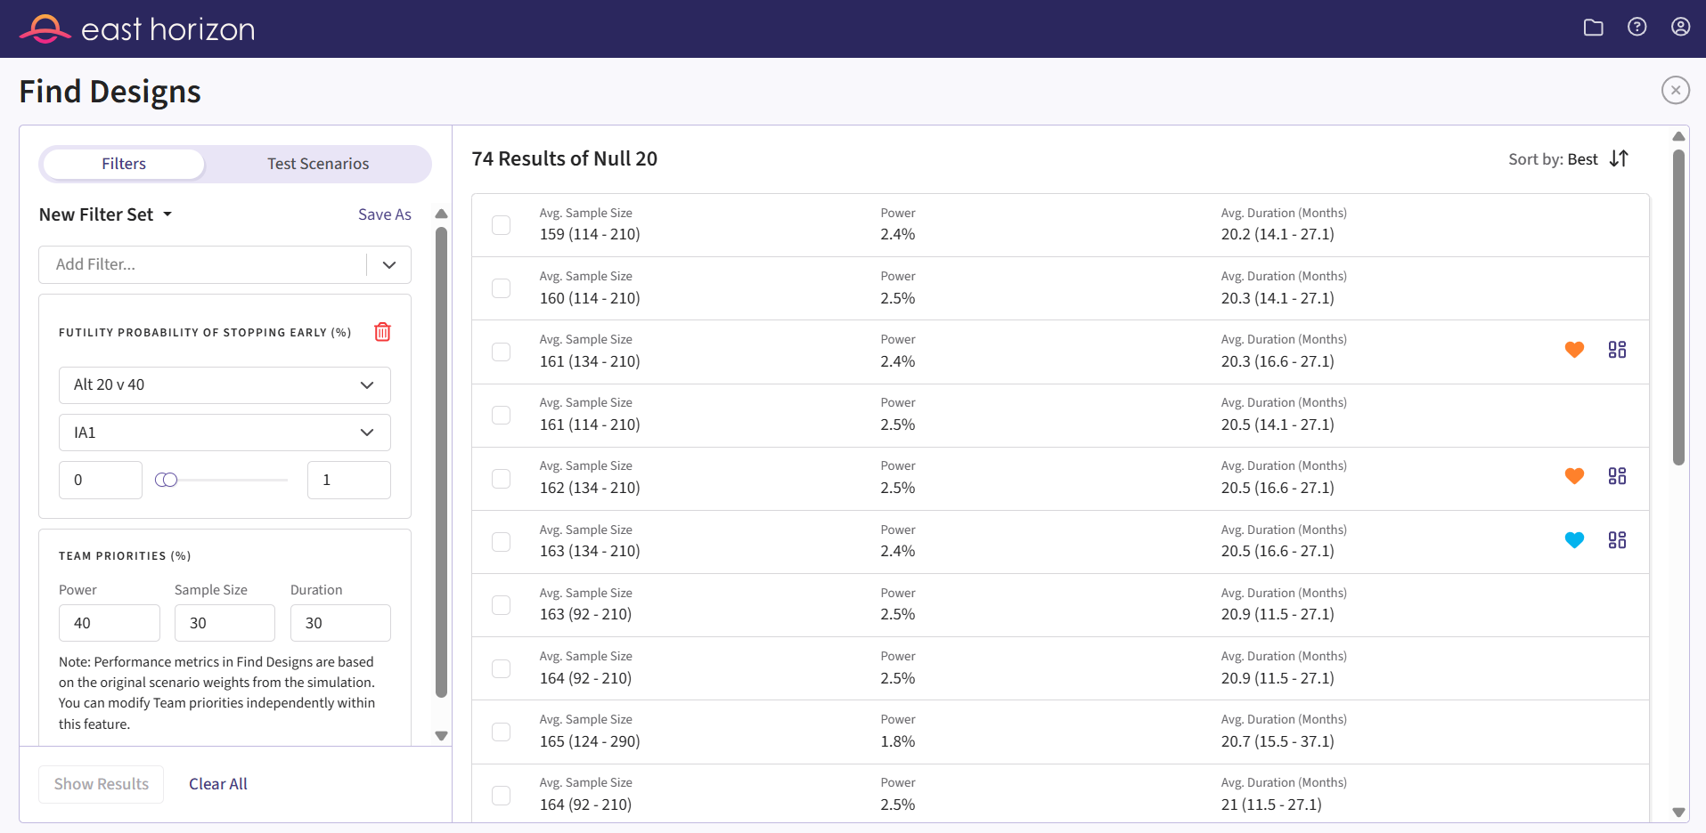

Slide 24
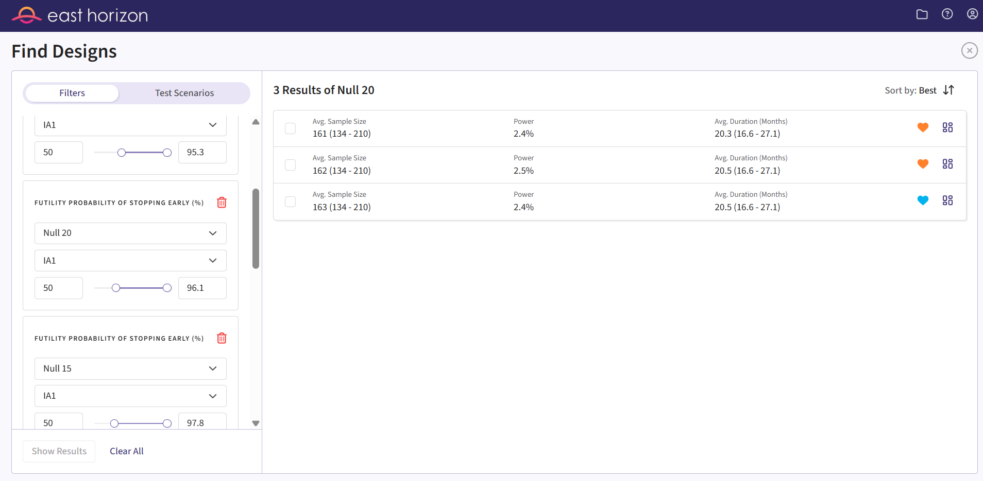
Futility constraints added
N = 210

Slide 25
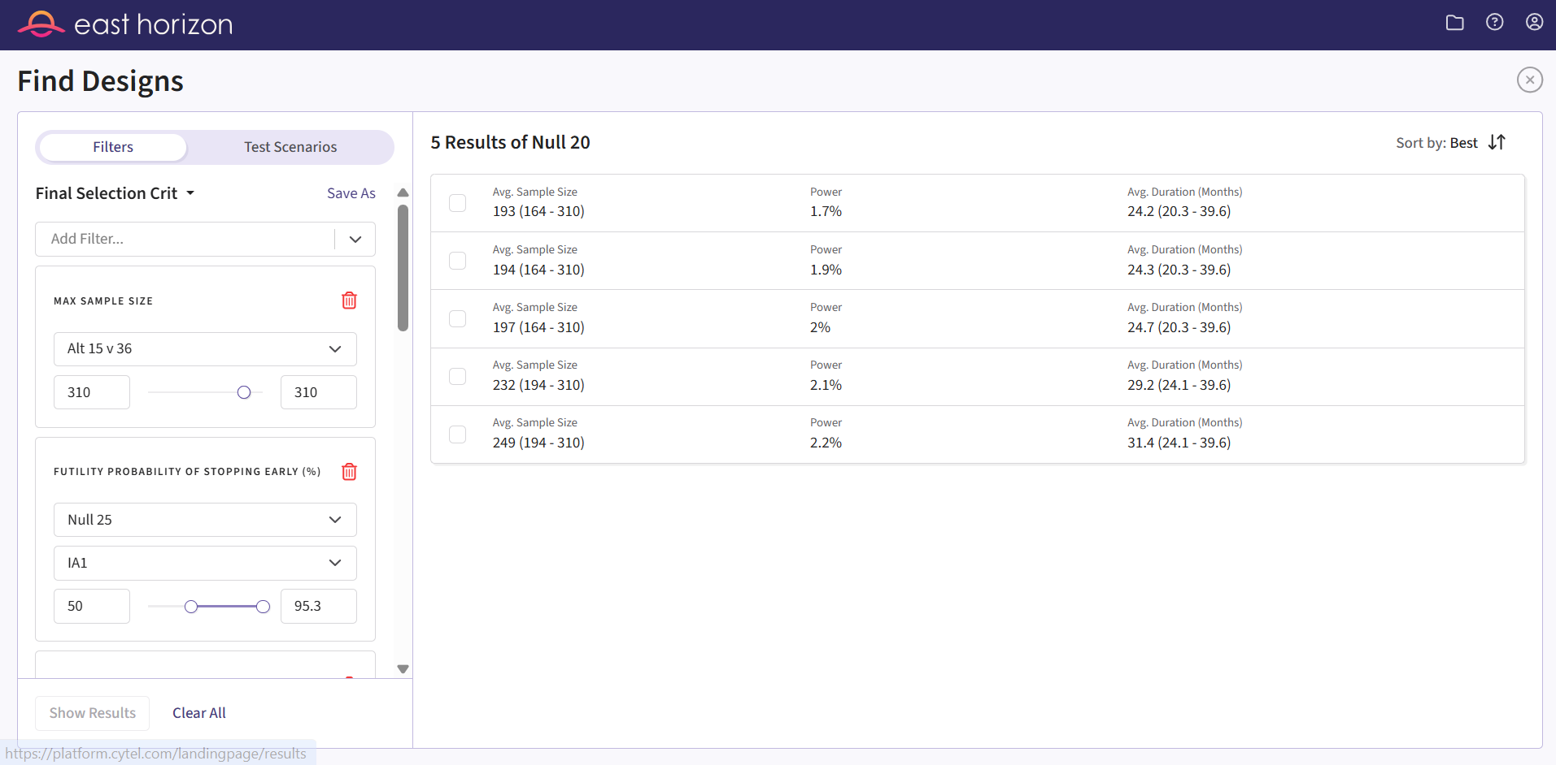
Futility constraints added
N = 310
1 Conditional Power Option meets the criteria

Slide 26
Simulation Summary
  Hierarchical Bayesian model included in the prediction for futility had the most robust performance
    Also applied if the same model is used for analysis (simulations not discussed)
  The Beta-Binomial model with historical data in the prediction for futility had robust performance
    MAJOR CAUTION – Not true in general, especially in therapeutic areas that have high trial to trial variation in the control response rate
    Not true if the same prior is used for analysis
  Conditional Power and Observed difference both meet the criteria if the futility probability in the alternative is increased to 2%-3%
    In general, required larger average sample size and slightly longer average trial duration

Slide 27
Summary
    Hybrid approach of East Horizon and the R integration removed limitations and allowed both frequentist and Bayesian options to be considered in the same software platform
    Use of the coding assistant reduced the code development time to under 1 hour for the Bayesian analysis, predictive probabilities, and hierarchical model/JAGS code
    Comparison of standard native approaches to newly published or exploratory options is greatly simplified with the R integration
      Patient arrival time, data generation, analysis
    General flow:
      R integration → CyneRgy → Anything in CyneRgy appears as a native option in East Horizon
      R integration → Private Client Repo → Appears as a native option in East Horizon for that client

Slide 28



Thank you!
J. Kyle Wathen
kyle.wathen@cytel.com

